Slide 1
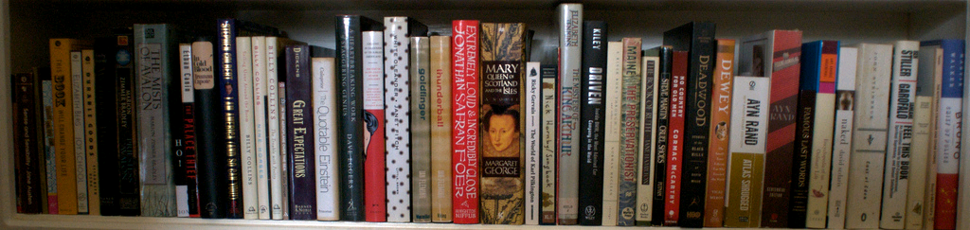
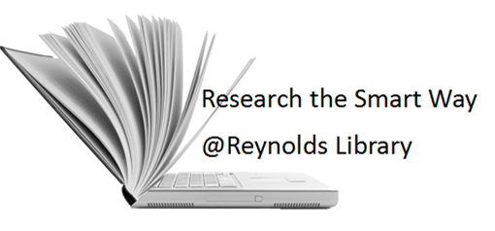
Reynolds Library
image from Flickr User eloquentlight's photostream
http://library.reynolds.edu

Slide 2
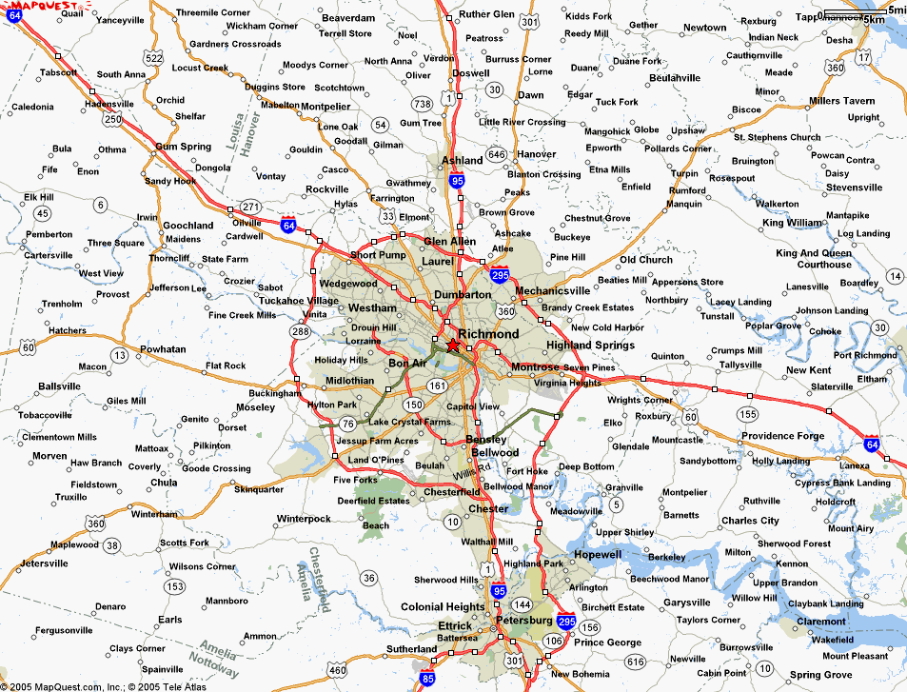
Where can you find us?
http://library.reynolds.edu
Goochland
Parham
Downtown

Slide 3
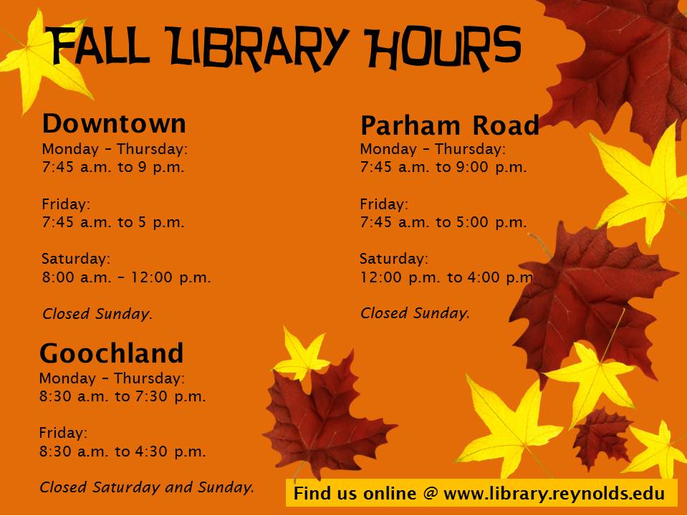

Slide 4
What do we have for you?
Books
Periodicals
Videos
Audio Books
Print: 90,000
Online: 40,000
Print: 597
DVDs: 3250
Online: 1000
Disc: 700
Online: 8750
Online: 50,000
Other Collections:
ESL
Career
Juvenile
Graphic
Educational & Popular
Notes:
According to the survey conducted by OCLC….

Slide 5
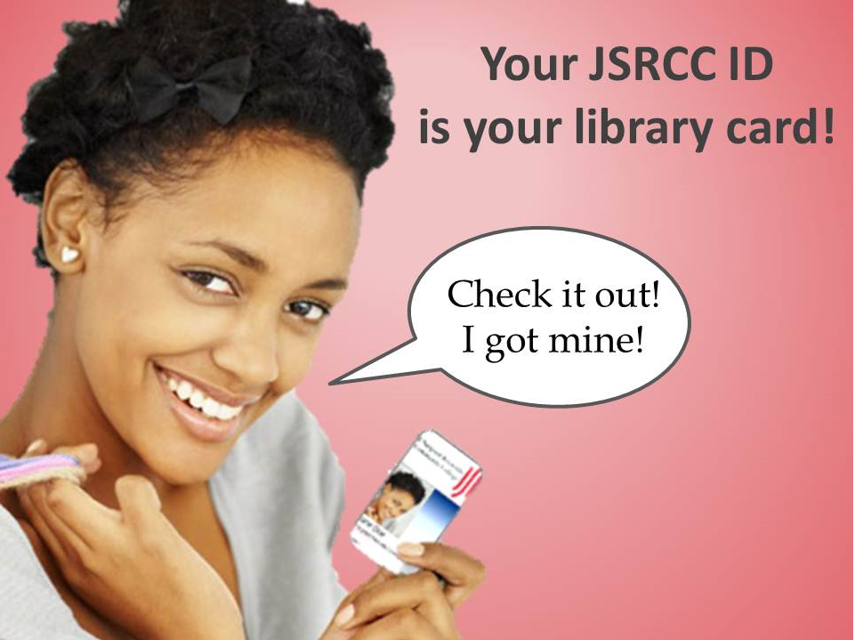

Slide 6
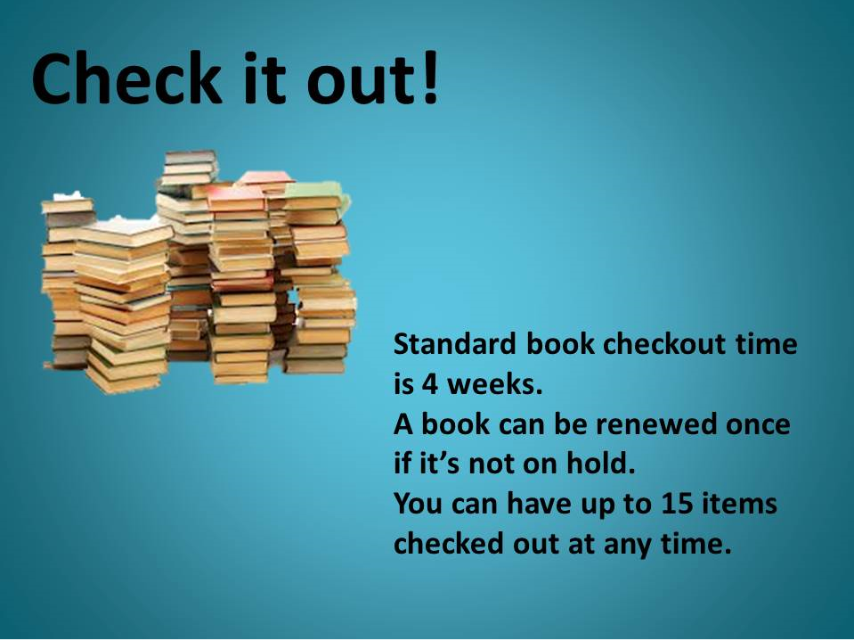

Slide 7
eBooks
over 100 dictionary, language and subject reference works
About 1,500 encyclopedias and specialized reference sources
Over 13,500 eBooks on business and technology
Over 17,000 eBooks in a variety of subject areas
Over 2,000 titles on behavioral, biomedical, computer & environmental sciences
700 titles from Elsevier’s 2013 collection of science, technology and medicine

Slide 8
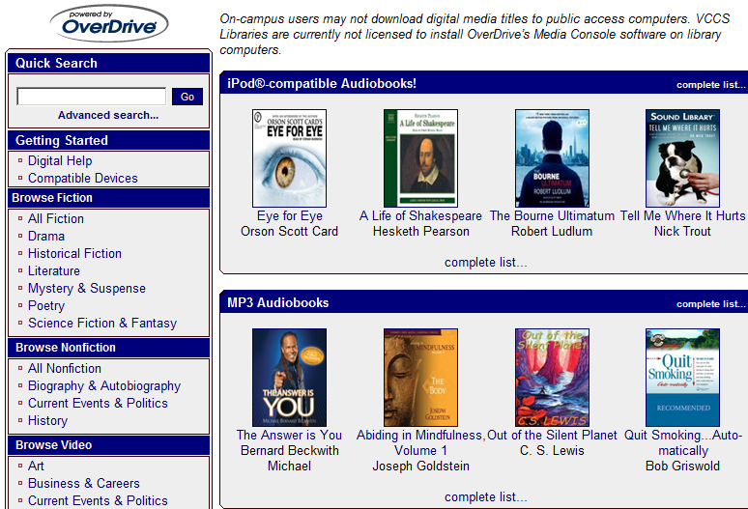
Audio Books: Online & Discs
Over 1000 online audio books with OverDrive and about 700 books on Discs

Slide 9
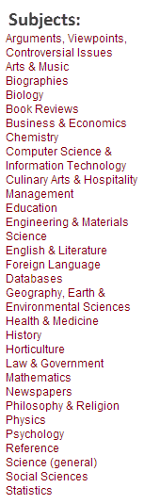
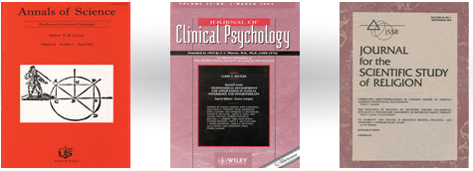
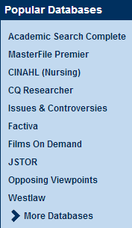

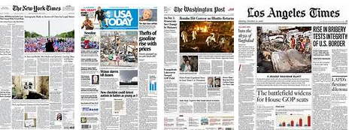
Article Databases

Slide 10
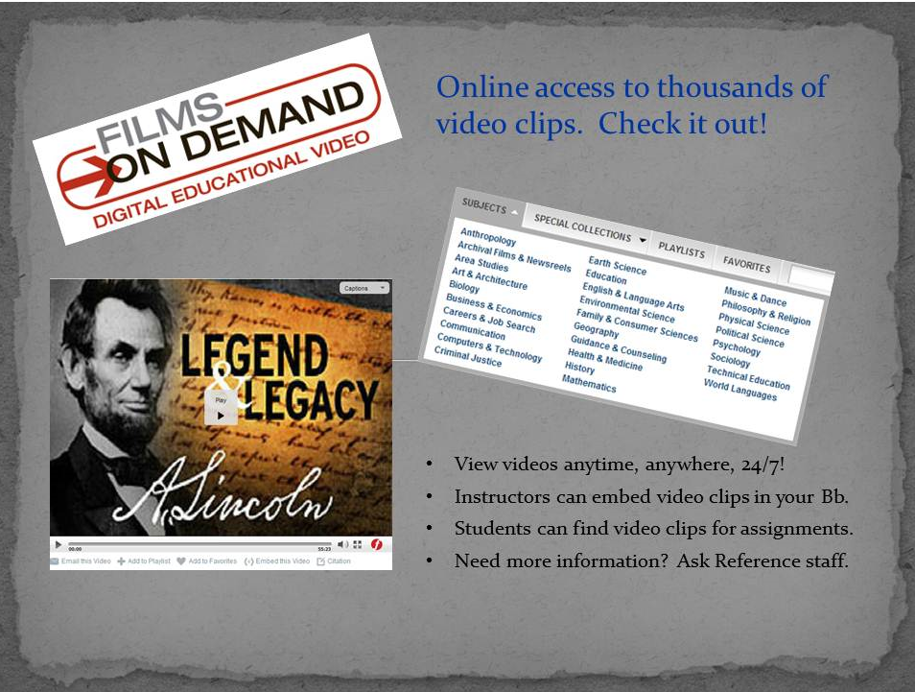

Slide 11
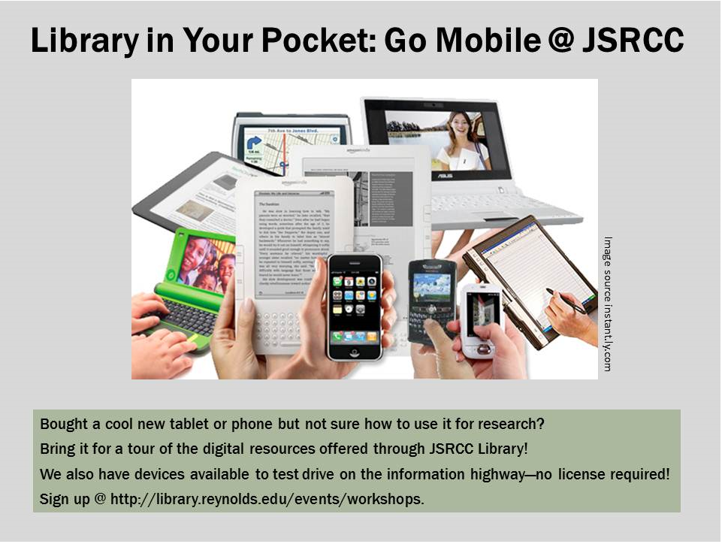

Slide 12
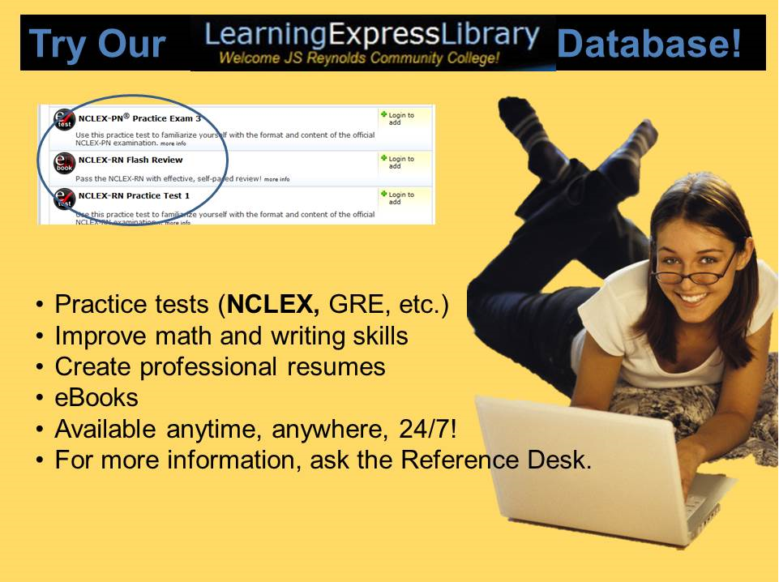

Slide 13


Slide 14
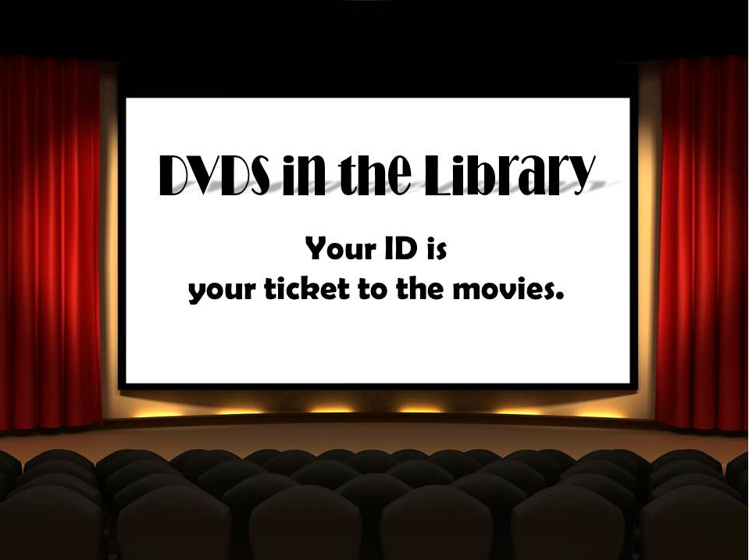

Slide 15

Off-Campus Access
You can access our online resources 24/7 from both on- and off-campus
“MyJSRCC” login is your key to enter our online databases from off-campus
Notes:
Image: http://www.123rf.com/photo_364562_around-the-clock.html
http://www.123rf.com/photo_1438015_gold-key-under-sun.html
Photo credit: http://www.onemedical.com/bos/how-we-work

Slide 16
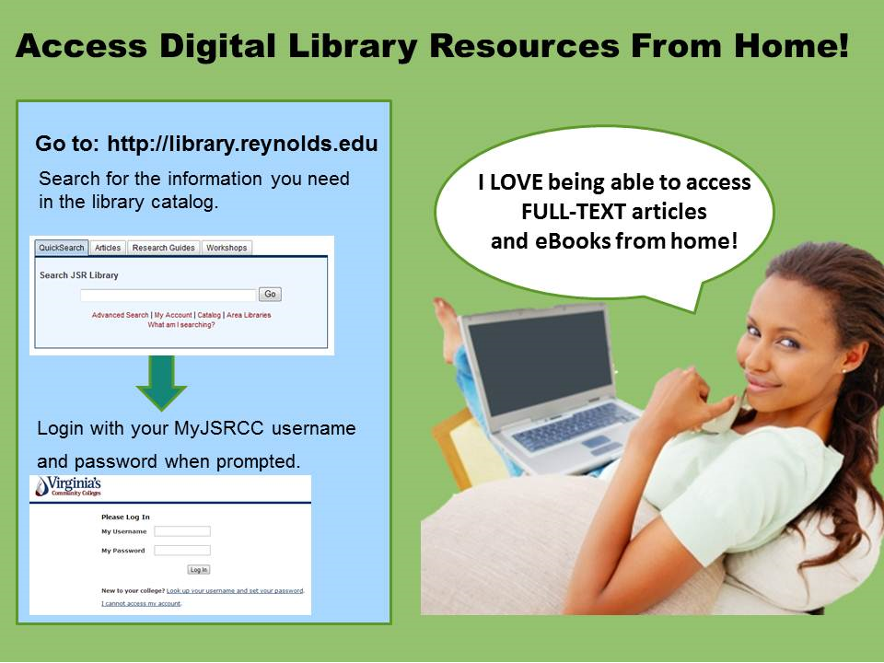

Slide 17

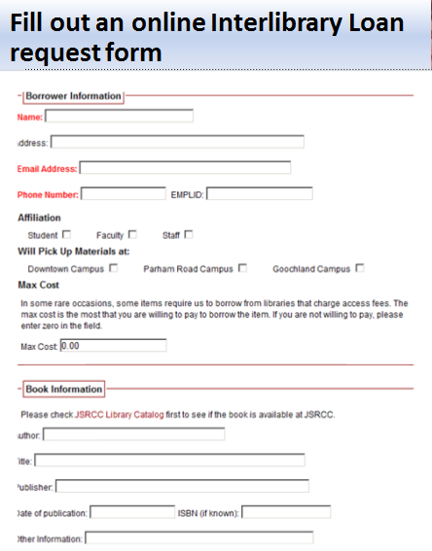

Beyond the Library…

Slide 18
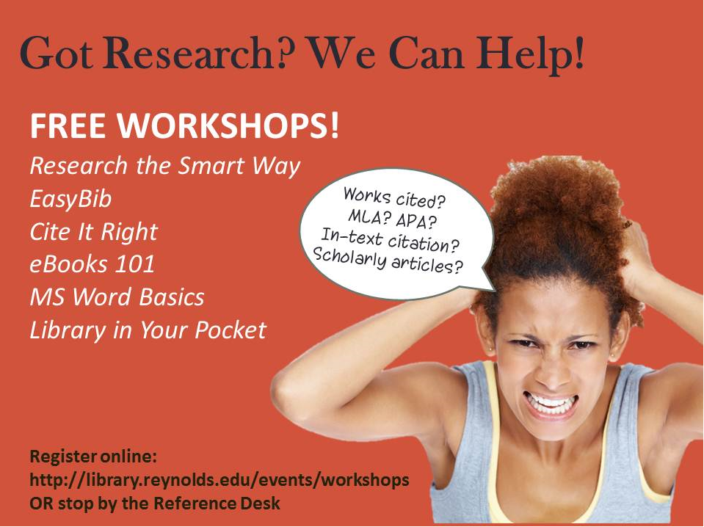

Slide 19
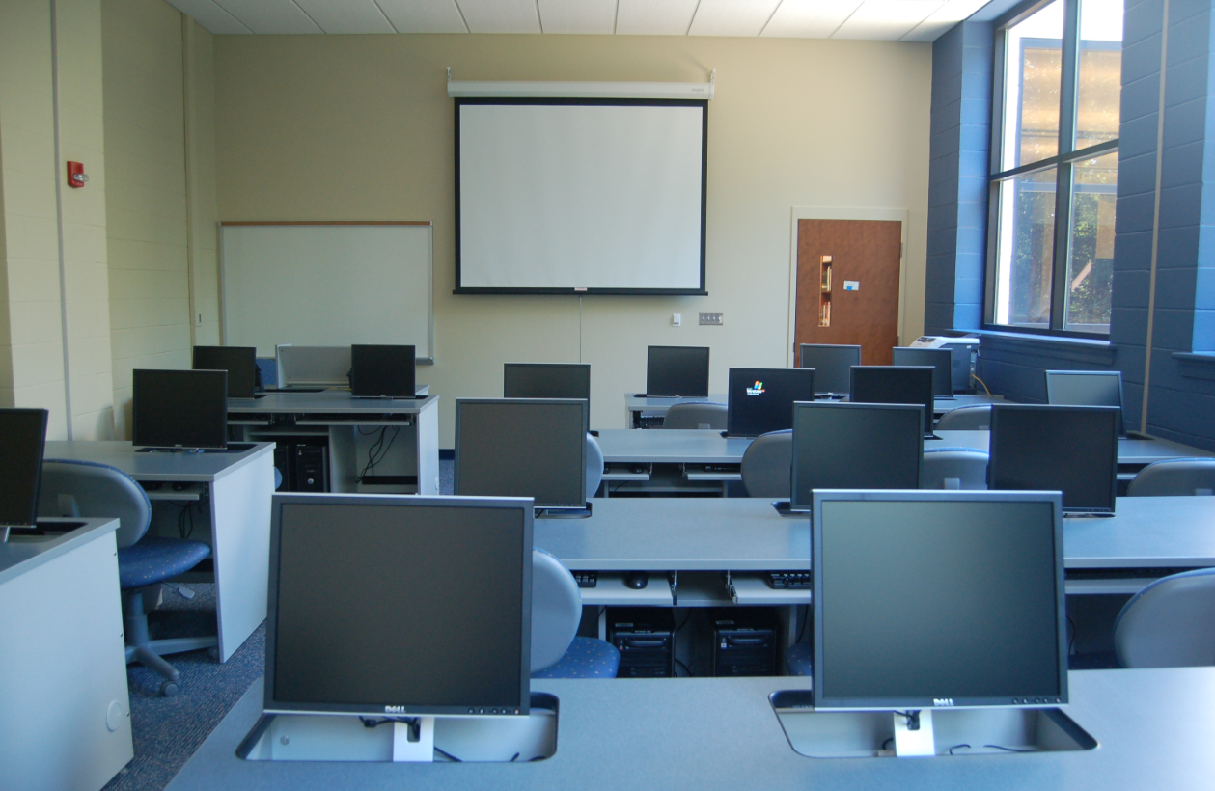
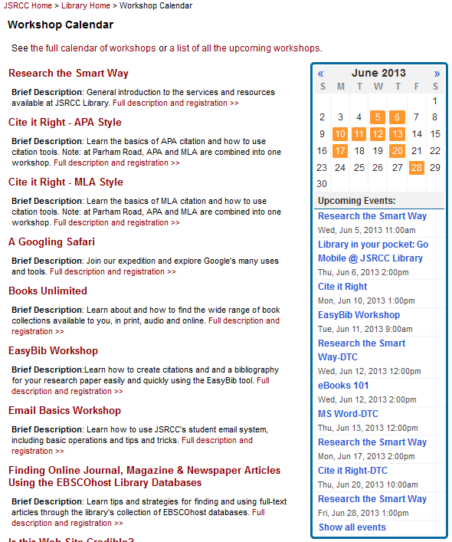
Open Session Library Workshops

Slide 20
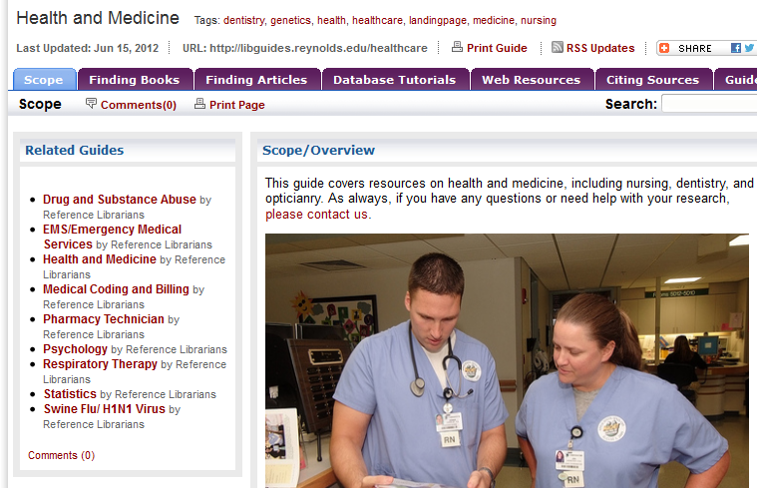
Research Guides

Slide 21
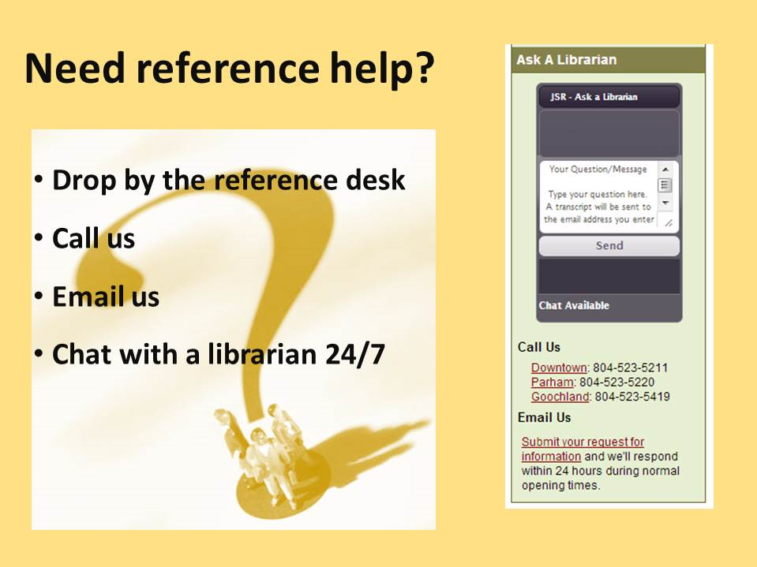

Slide 22
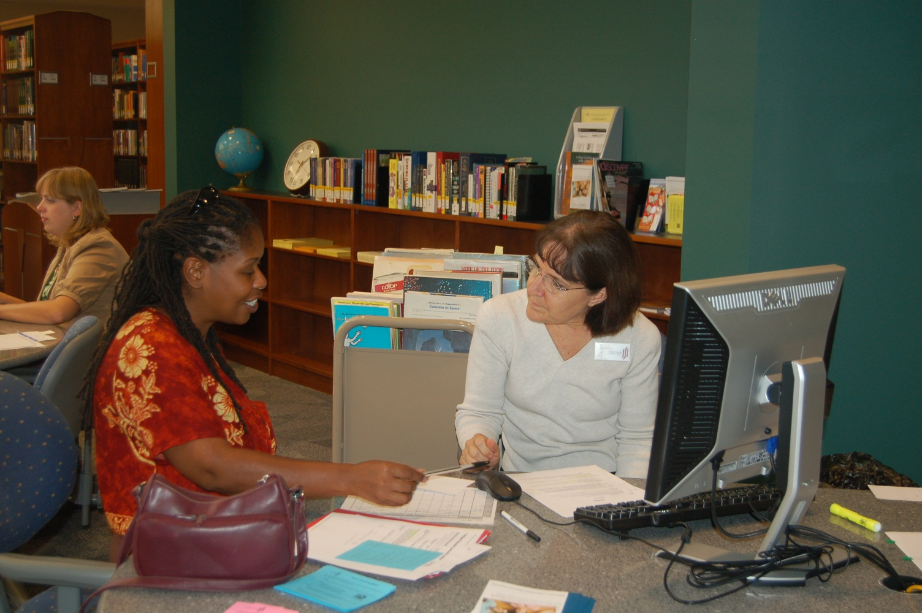
Research Consultations

Slide 23
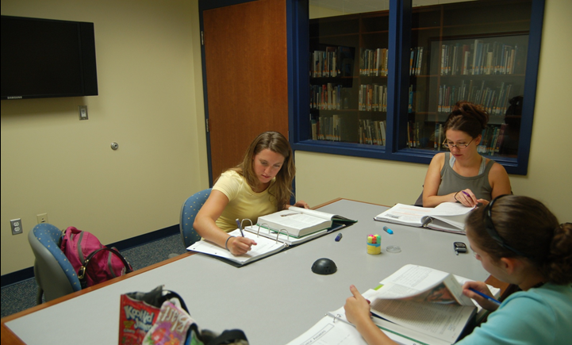
Group Study Rooms for Collaborative Projects
PRC – 8 rooms / DTC – 3 rooms / GC – 1 room

Slide 24
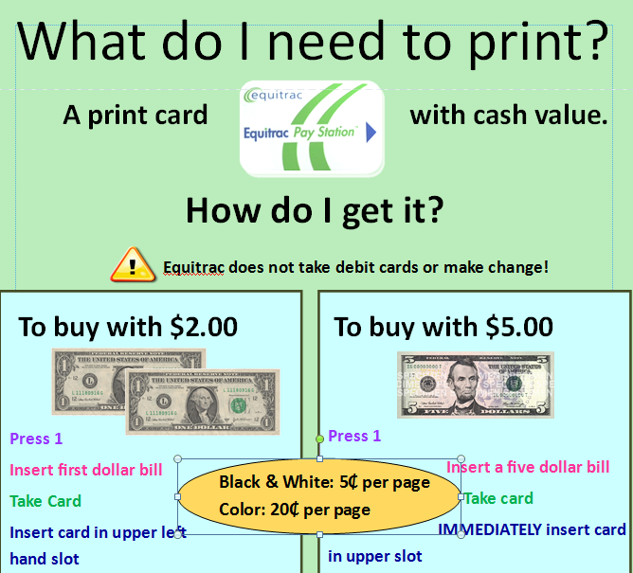
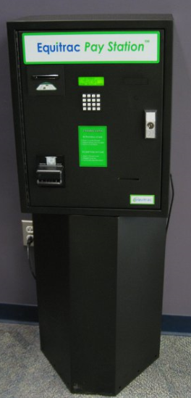
Printing & Photocopying

Slide 25

Stay Connected with the Library
Facebook
Twitter
Library Blog

Slide 26
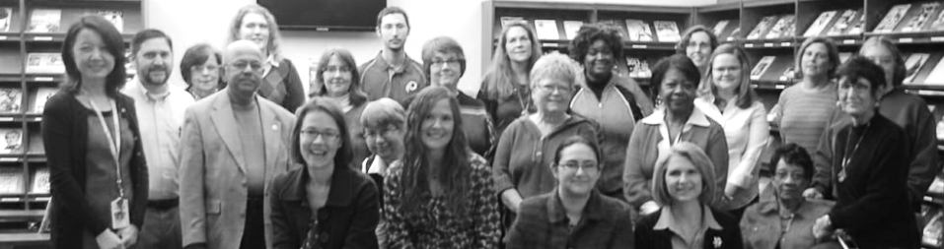
Thank You!
We are looking forward to serving you!
http://library.reynolds.edu

